Slide 1


SALES PERFORMANCE ANALYSIS
•Maven Global Electronics Retailer
•Power BI Project
By
Busayo Ajayi
Data Analyst

Slide 2
Executive Summary
Objective:
Create a sales performance dashboard for a global electronics retailer to consolidate and analyze sales, customer, product, and store data. The dashboard will track key performance metrics, uncover sales trends, and provide actionable insights for management to make data-driven decisions.
Company Overview:
Maven Electronics is a global retailer that sells computers, cell phones, TVs, cameras, appliances, and other consumer products through both online and in-store channels. The company operates across multiple regions and aims to improve profitability, monitor store and product performance, and enhance customer satisfaction
Business Problem:
Revenue has declined since 2020, while management lacks a unified view of performance across sales channels, regions, and customers. This limits the ability to identify key drivers of growth and areas of decline, highlighting the need for a consolidated data model and interactive dashboard.

Slide 3
SOLUTION
1.Power BI Data Model: Star schema connecting fact and dimension tables.
2.Interactive Dashboard: 3-4 pages covering KPIs, trends,product/customer insights, and store performance
3.Final Presentation: Insights and recommendations based on the analysis
4.Deliver actionable insights for teams
5.Report Published to Power BI Service: Interactive, shareable report for management

Slide 4
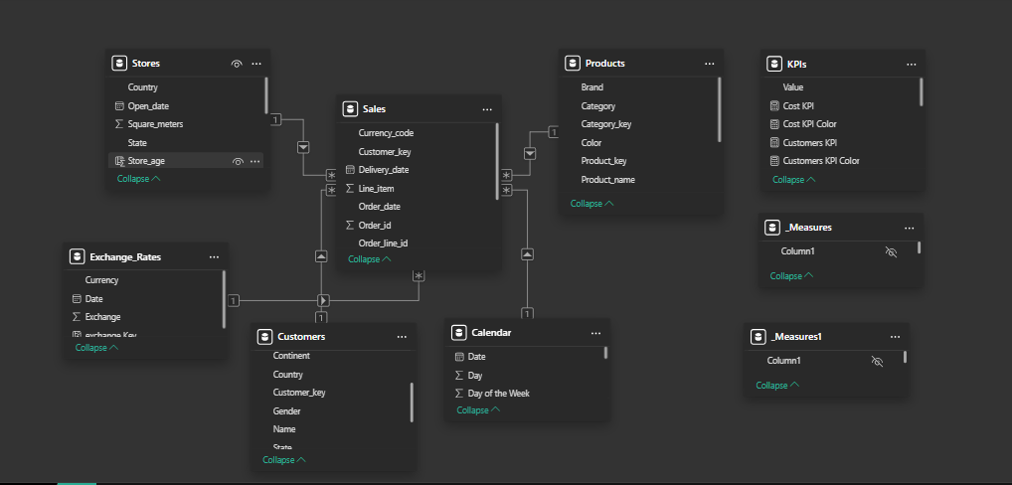
Data Model Overview:

Slide 5
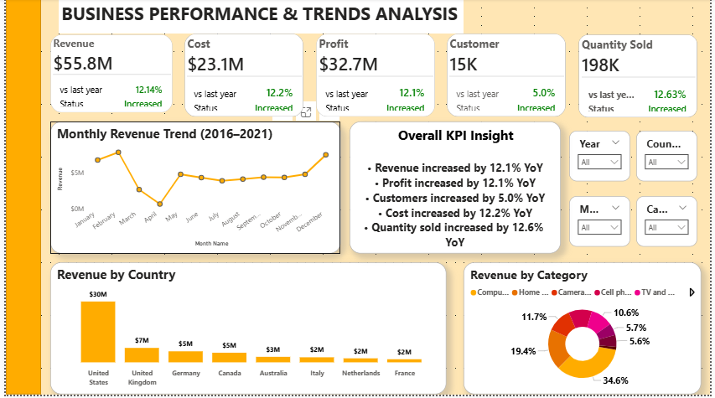

Slide 6
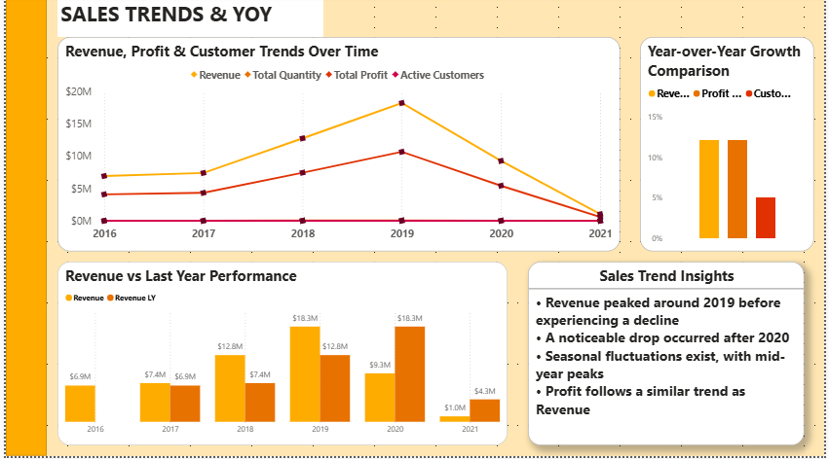

Slide 7
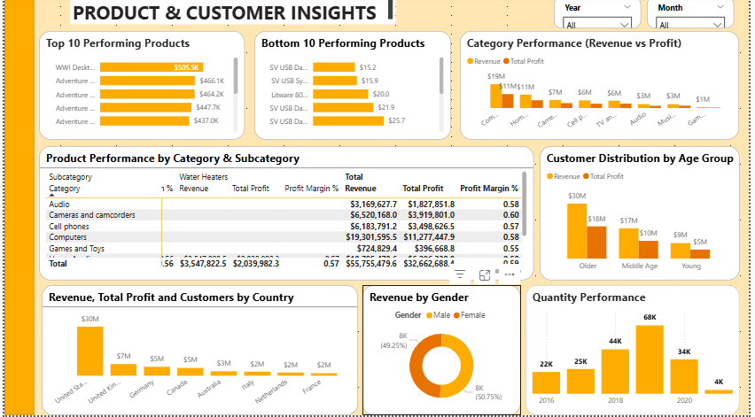

Slide 8
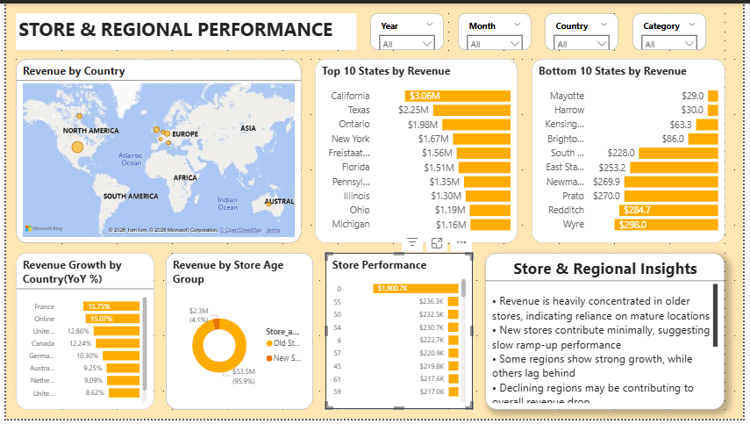

Slide 9
KEY FINDING
Profit Margin /Product & Customer / Store & Region Insight
Profit margin remain relatively stable across categories, averaging around 55%–60% ,
There is no significant evidence of margin shrinkage, The profit margins remain stable across time and categories, which indicates pricing and cost structures haven’t significantly changed
This suggests that declining performance is likely driven by reduced sales volume rather than rising costs or discounting
Revenue is heavily driven by a small number of top-performing products, particularly in Computers, Cameras, and Cell Phones
A significant number of products are underperforming, contributing little to overall revenue and indicating inefficiencies in the product portfolio
The gap between top and bottom products is substantial, highlighting reliance on a limited set of high-performing items
Older customers generate the highest revenue share
New stores contribute minimally, suggesting slow ramp-up performance
Some regions show strong growth, while others lag behind
Top-performing states generate significantly higher revenue than others
Bottom-performing states contribute minimal revenue and may require strategic review
Growth rates vary across countries, indicating uneven regional performance
Overall, the revenue decline is likely driven by reduced demand rather than profitability challenges.

Slide 10
Recommendations
To reverse the revenue decline, the business should focus on rebuilding customer demand, reducing product concentration risk, and improving performance across weaker regions and newer stores.
1. Rebuild demand by strengthening customer acquisition and retention, particularly targeting under-engaged segments
2. Optimize the product portfolio by scaling high-performing products and reviewing or discontinuing underperforming ones
3.Address regional performance gaps by investigating declining markets and reallocating investment to high-growth areas
4. • Improve new store performance by applying best practices from top-performing locations to accelerate ramp-up

